Slide 1


SMS SPAM DETECTION
Artificial Intelligence for Cybersecurity
Pierfrancesco Bigliazzi

Slide 2






TABLE OF CONTENTS
GOAL
CLASSIFICATION
Detect spam SMS with ML classification techniques
Perform the classification of the data with different classifiers
DATA PRE-PROCESSING
CROSS VALIDATION
Import dataset, clean data and add new features
Evaluate the results with K-fold cross validator
DATA ANALYSIS
CONCLUSIONS
Analysis of the data in order to discover some useful information
Project final results and possible improvements

Slide 3

GOAL OF THE WORK
Nowadays spam messages are becoming more and more common, so it’s very easy to receive one or more than one. This project aims to develop a spam filter by using several classifiers in order to improve the user experience

Slide 4

DATASET
The SMS Spam Collection is a set of SMS tagged messages that have been collected for SMS Spam research. It contains one set of SMS messages in English of 5,574 messages, tagged according being ham (legitimate) or spam.
Ham messages: 4827
Spam messages: 747

Slide 5

DATA PREPROCESSING
Import Dataset: we import the dataset and transfom it in a dataframe
Data Cleaning: remove possible null values and remove possible duplicates
Data Preprocessing: add some useful features

Slide 6

DATA ANALYSIS
HISTOGRAMS
COUNTPLOTS
HEATMAP
WORDCLOUD

Slide 7
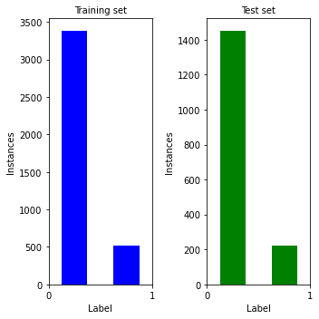
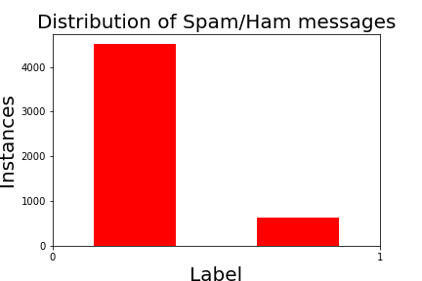
DATA DISTRIBUTION

Slide 8
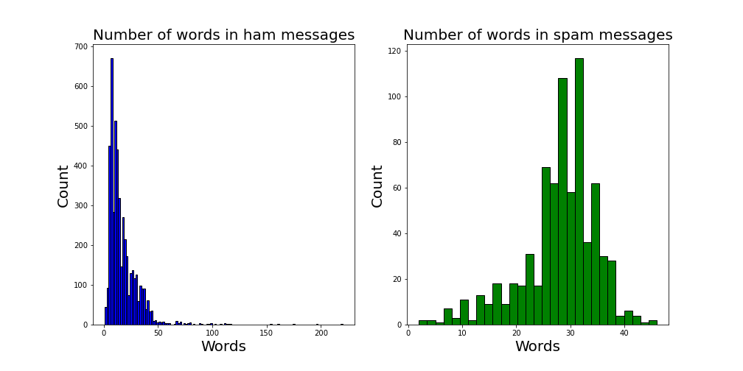
WORDS DISTRIBUTION

Slide 9
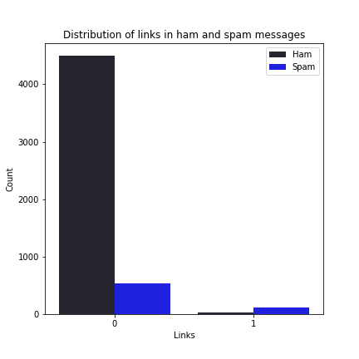
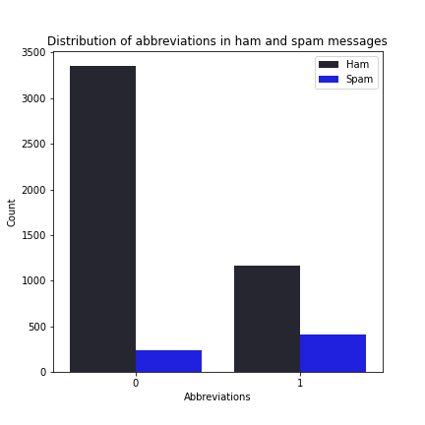
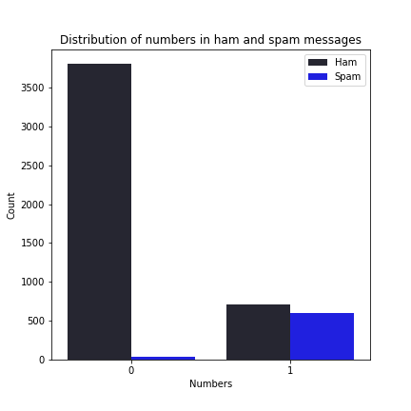
SPECIAL CHARACTERS DISTRIBUTION
Links tend to be more present in spam messages
Abbreviations, instead, are more present in ham messages
Numbers are present in ham and spam messages in an equal manner

Slide 10
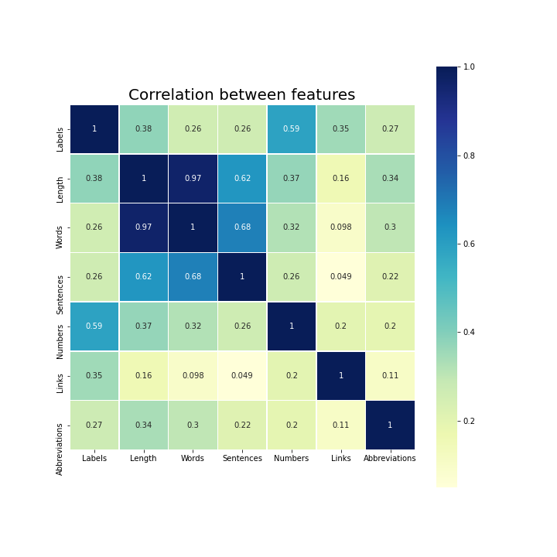
CORRELATION MATRIX
Numbers and the length of the message are the features more correlated with spam SMS.
Instead, the number of words and the number of sentences are more connected with ham messages

Slide 11


Slide 12
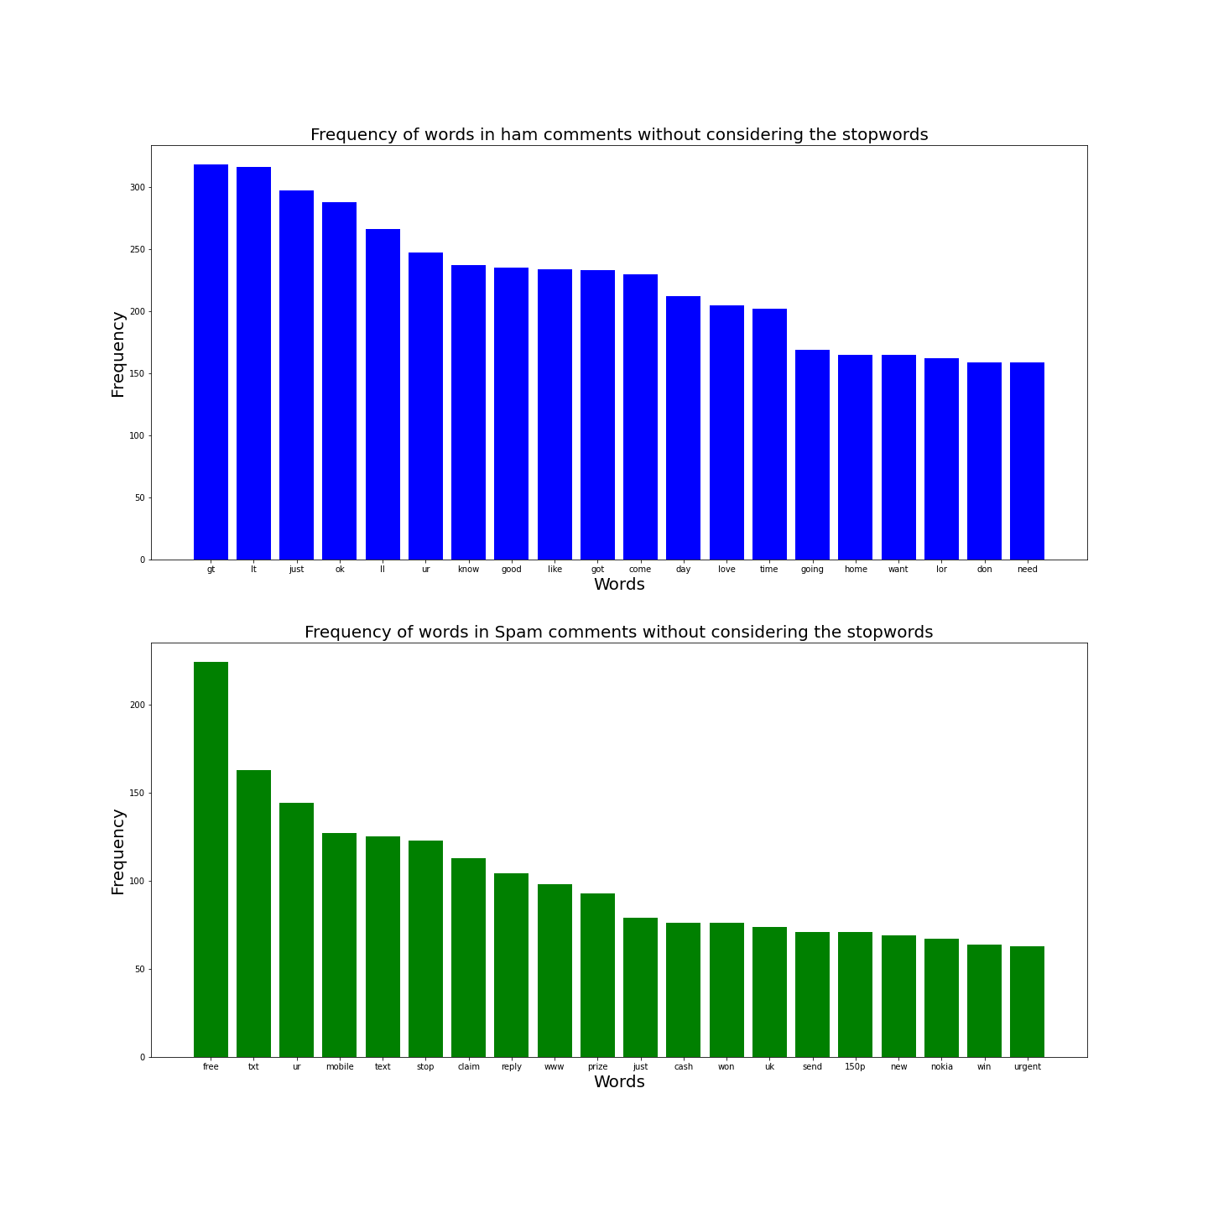

Slide 13

COUNT VECTORIZER
CountVectorizer converts a collection of text documents to a matrix of token counts. The matrix is a sparse matrix where each row represents a document and each column represents a unique word. Each cells contains the frequency of the word in that particular document.
Thanks to the use of analyzer, stopwords and punctuation are removed and not represented in the sparse matrix.

Slide 14
CLASSIFIERS
SVC
Multinomial Naive Bayes
Guassian Naive Bayes

Slide 15
CLASSIFIERS
Decision Tree
Logistic Regression
Random Forest

Slide 16
RESULTS
Classifier | Confusion Matrix | Accuracy | Recall | Precision | F1
SVC | [[1354 1] [ 37 156]] | 0.975 | 0.808 | 0.993 | 0.891
Multinomial Naive Bayes | [[1349 6] [ 26 167]] | 0.979 | 0.865 | 0.965 | 0.912
Gaussian Naive Bayes | [[1209 146] [ 23 170]] | 0.89 | 0.88 | 0.537 | 0.667
Decision Tree | [[1331 24] [ 35 158]] | 0.961 | 0.818 | 0.868 | 0.842
Logistic Regression | [[1351 4] [ 27 166]] | 0.979 | 0.86 | 0.976 | 0.914
Random Forest | [[1355 0] [ 45 148]] | 0.97 | 0.766 | 1 | 0.868

Slide 17
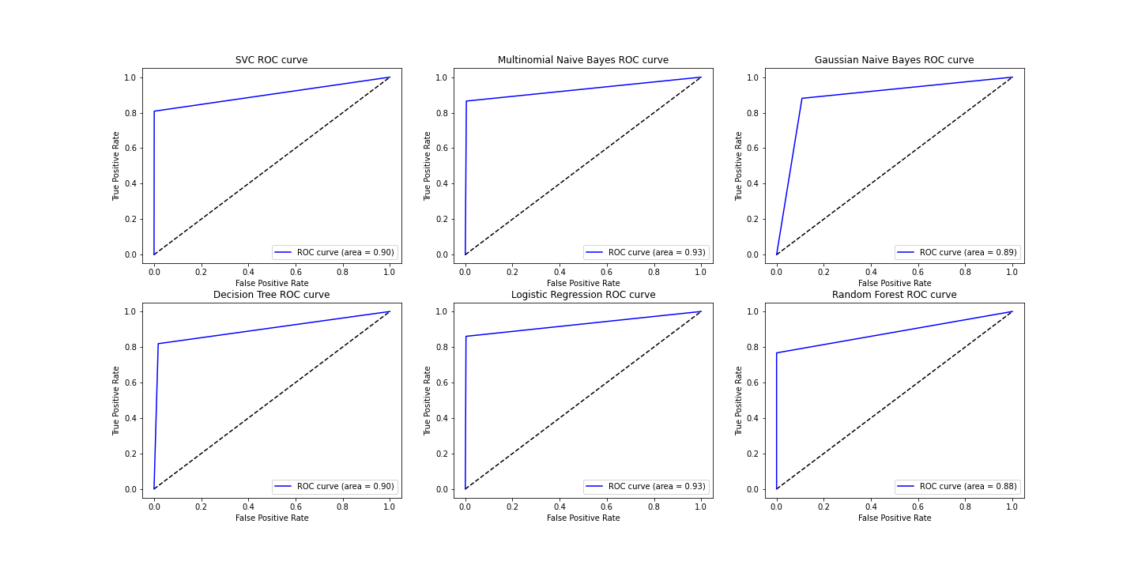
ROC CURVES

Slide 18
STRATIFIED K-FOLD CROSS VALIDATION
Classifier | Confusion Matrix | Accuracy | Recall | Precision | F1
SVC | [[4516 2] [ 115 527]] | 0.977 | 0.91 | 0.986 | 0.943
Multinomial Naive Bayes | [[4454 64] [ 49 593]] | 0.978 | 0.955 | 0.947 | 0.95
Gaussian Naive Bayes | [[3964 554] [ 75 567]] | 0.878 | 0.88 | 0.744 | 0.785
Decision Tree | [[4441 77] [ 139 503]] | 0.959 | 0.888 | 0.92 | 0.902
Logistic Regression | [[4508 10] [ 92 550]] | 0.98 | 0.927 | 0.981 | 0.952
Random Forest | [[4506 12] [ 134 508]] | 0.972 | 0.894 | 0.982 | 0.931

Slide 19

CONCLUSIONS
The algorithms used in this project were able to perform a good classification of messages. In particular, Multinomial Naive Bayes and Logistic Regression achieved the best results overall.
AUC_MNB = 0.93 AUC_LR = 0.93
Accuracy_MNB = 0.978 Accuracy_LR = 0.98
Recall_MNB = 0.955 Recall_LR = 0.927
Precision_MNB = 0.947 Precision_LR = 0.981
F1_MNB = 0.95 F1_LR = 0.952

Slide 20

POSSIBLE IMPROVEMENTS
Enlarge the dataset with more samples of the most relevant class (in this case spam messages).
Try to use deep learning algorithms like neural networks.
Try to use different approaches to perform the tokenization of the messages.

